Slide 1
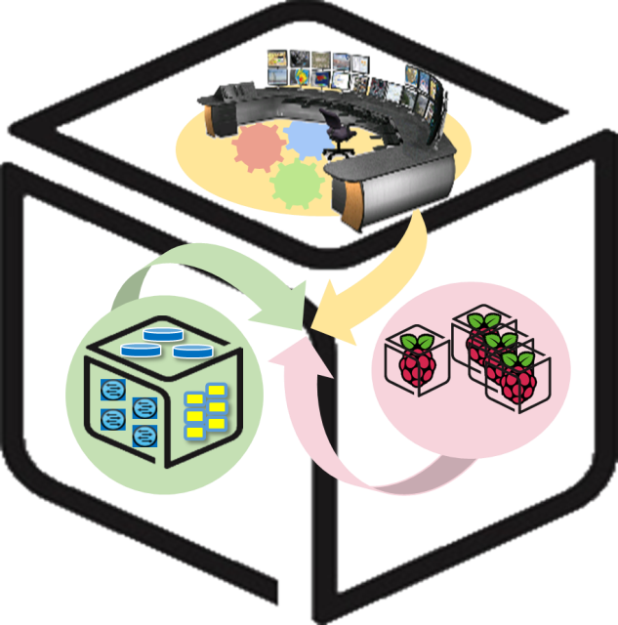
SmartX Labs for Computer Systems
Box Lab v1.3
(2018, Spring)
NetCS Lab

Slide 2
History and Contributor of Box Lab
2016
Version | Updated Date | Updated Contents | Contributor
V0.1 | 2015/09 | OvS, Docker 자료 초안 작성 | 배 정 주
V0.2 | 2015/09 | KVM 자료 초안 작성 | 윤 희 범
V0.3 | 2015/10 | 자료 취합 및 Functions Lab 초안 제작 | 배 정 주
V0.4 | 2015/10 | Functions Lab 자료 편집 및 수정 | 윤 희 범
V0.5 | 2016/03 | Function Lab → Box Lab 이전 작업, 세부자료 수정 | 남 택 호
V0.6 | 2016/04 | 추가 설명자료 및 단어 교정, History 작성 | 남 택 호
V0.7 | 2016/04 | Outline 추가, 검수자 피드백 반영 | 남 택 호
V0.8 | 2016/04 | 실습 중 발생한 이슈에 대한 개선사항 추가 (docker container command, if configuration 충돌) | 남 택 호
V0.9 | 2016/06 | 불필요한 Prerequisite 제거, Appendix 추가 (mirror site 변경코드 제거) | 남 택 호 김 병 돈
2017
Version | Updated Date | Updated Contents | Contributor
V1.0 | 2017/01 | KVM을 활용한 VM 생성시 사용하는 이미지 주소 변경 | 남 택 호
V1.1 | 2017/04 | OS version update(16.04), Network setting issue 정리 | 남 택 호
V1.2 | 2017/04 | KVM VM 생성 후 부팅 문제 해결, 검수 및 테스트 검증 | 남 택 호
2018
Version | Updated Date | Updated Contents | Contributor
V1.3 | 2017/04 | VM, Container 개념 자료 보강, Ubuntu 16.04 이미지 다운로드 경로 수정, VM OS 설치 과정 수정(Ubuntu image cdrom eject) | 권 진 철
V1.4 | 2017/04 | 일부 명령어 최신화 및 최적화 | 강 문 중

Slide 3




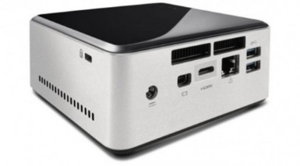
Box Lab: Outline
VM
Container
Tap1
ping test
br0
em1

Slide 4
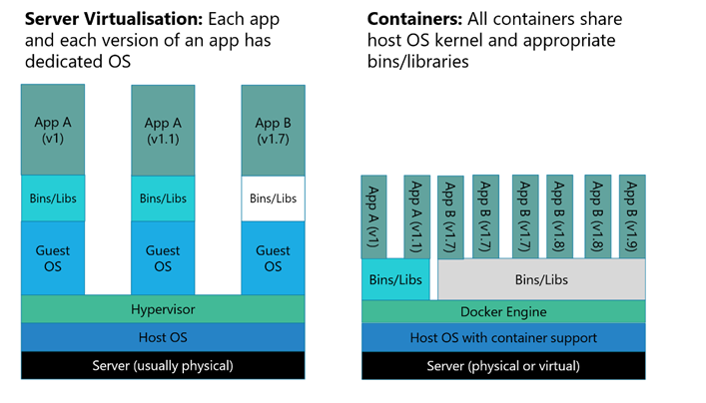
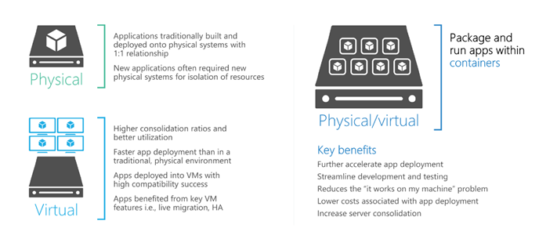
Virtualization: Virtual Machine, Container

Slide 5
Virtualization: Basic Concept
Tenant A Virtual
Network
Tenant B Virtual
Network
Tenant C Virtual
Network
Network Virtualization
Any Physical Network
(Packet Forwarding)

Slide 6
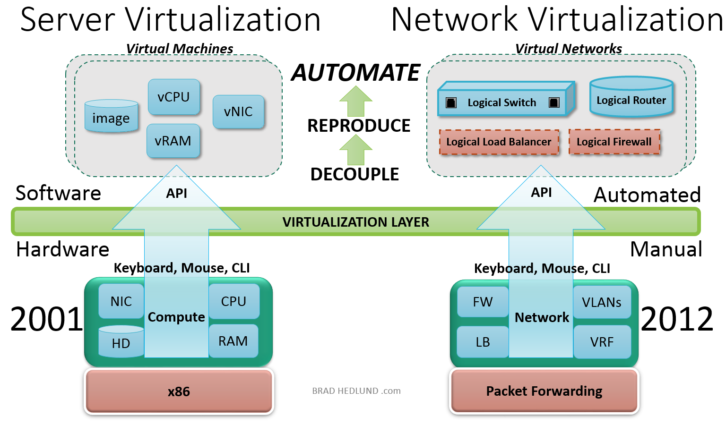
Virtualization: Basic Concept
Virtualization is the basic act of decoupling an infrastructure service from the physical assets on which that service operates. With the virtual network fully decoupled, the physical network configuration is simplified to provide packet forwarding service from one hypervisor to the next
http://bradhedlund.com/2013/05/28/what-is-network-virtualization/

Slide 7


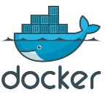

Box Lab: Final Goal
VM

Slide 8
Open vSwitch: Goal of this part
- Update and Configuration

Slide 9
vSwitches: Virtual(soft) Switches
A switch for every server means a 50:1 (virtual : physical) ratio; Approaching feature-­parity with hardware switches: Visibility, ACLs, Quality of Service; Optionally leveraging hardware oﬀ-loading
Tight integration with hypervisor ➔ Good for virtual edge (e.g., inter-VM) networking, network overlay: the leading initial NV use case
Centralized management
VMWare, Nicira (open & proprietary), Cisco, IBM, Microsoft
VMware vSwitch (vDS), Cisco Nexus 1000V, Open vSwitch

Slide 10
Virtual Switches: Soft vs Hardware
H/W Switches: With an approach like pass through + tagging + switching in the NIC (with enforcement in the first hop switch); Latency is reduced to the wire speed; Packet classification noticeably outperforms x86-based software switches.
S/W Switches: Flexibility and upgrade cycle of software + Benefits of virtualization (memory overcommit, page sharing, etc.); Simple resource efficiency
Can saturate a 10G link from a guest to the wire with less than a x86 CPU core (assuming MTU size packets), Can saturate a 1G link with less than 20% of a core. In the case of Open vSwitch, these numbers include full packet lookup over L2, L3 and L4 headers.

Slide 11
Virtual Switch: Basic Architecture
Virtual L2 network
Hypervisor
VM
VM
VM
VM
Virtual NIC
Virtual
interface
Virtual switch
Physical switch

Slide 12
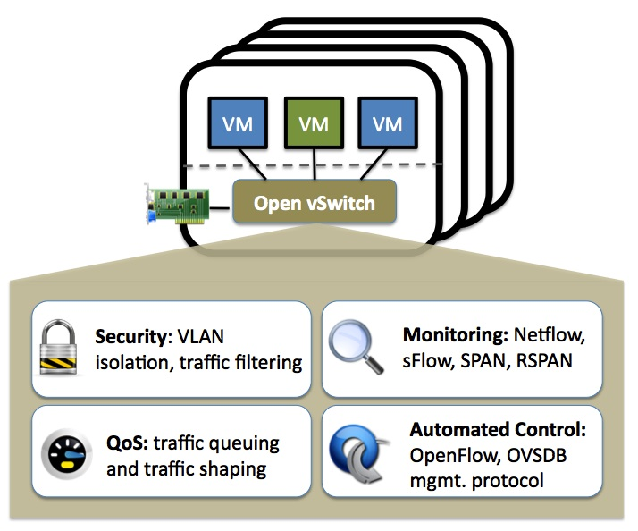
Open vSwitch: Introduction
http://openvswitch.org/

Slide 13















Open vSwitch: Main Components
Control Cluster
Oﬀ-­‐box
ovsdb-­‐server
ovs-­‐vswitchd
User Kernel
Management Protocol (6632/TCP) OpenFlow (6633/TCP)
Netlink
Openvswitch_mod.ko

Slide 14
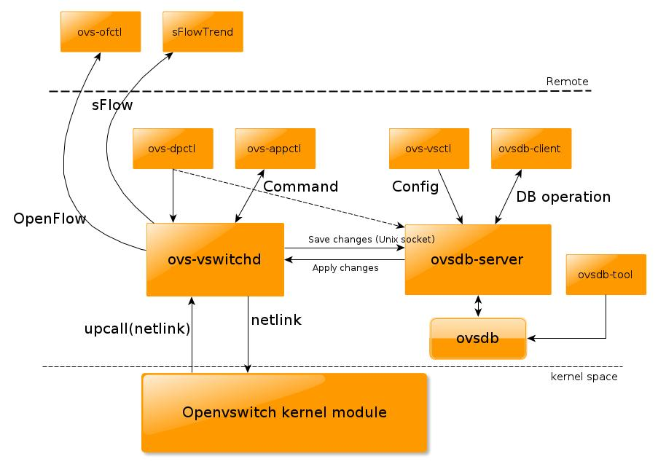
Open vSwitch: All Components

Slide 15
Prerequisite for Box Lab
Installed 64bit Ubuntu 16.04 LTS in Intel NUC
(We recommend to use desktop version)

Slide 16

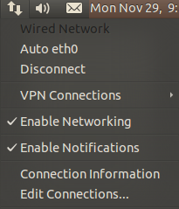
Prerequisite for Box Lab
Do not check ‘Enable Networking’
$sudo vi /etc/network/interfaces
----------------- /etc/network/interfaces -----------------
auto lo
iface lo inet loopback
auto eth0
iface eth0 inet static
address [ip address]
netmask [subnet mask]
gateway [gateway]
dns-nameservers [nameserver 1] [nameserver 2]
----------------------------------------------------------------------------
$sudo ifdown eth0
$sudo ifup eth0
15

Slide 17
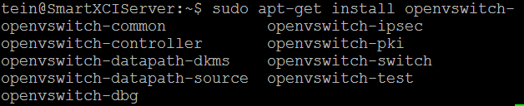
OpenVswitch - Update & Install
Update index information of Open vSwitch package.
Install a Open vSwitch package, openvswitch-switch.
Other dependencies are automatically installed.
$sudo apt-get update
$sudo apt-get install openvswitch-switch

Slide 18
Open vSwitch
- Basic command (ovs-vsctl)
※You don’t need to follow below command.
$sudo ovs-vsctl add-br <bridge_name>
$sudo ovs-vsctl add-port <bridge_name> <NIC>
$sudo ovs-vsctl add-port <bridge_name> <port_name>
$sudo ovs-vsctl del-br <bridge_name>
$sudo ovs-vsctl del-port <port_name>
Example)
※You don’t need to follow below command.
$sudo ovs-vsctl add-br br0
$sudo ovs-vsctl add-port br0 eth0
$sudo ovs-vsctl add-port br0 po_to_anotherBr
po_to_anotherBr
br0
br0
eth0
eth0

Slide 19
Open vSwitch
- Interface configuration setting
Example)
※You don’t need to follow below command.
$sudo ifconfig eth0 0
$sudo ifconfig br0 0
$sudo ifup br0
$sudo ifconfig br0 up
$sudo ifconfig br0 203.237.x.x
$sudo ifconfig eth0 up
br0
br0
ip : 203.237.x.x
eth0
ip : 203.237.x.x
eth0
ip : 0

Slide 20
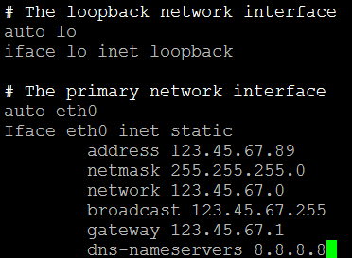
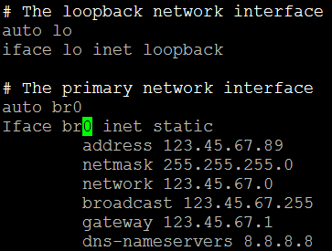
Open Vswitch - Configure bridged networking
Modify network interface configuration.
$sudo vi /etc/network/interfaces
----------------- /etc/network/interfaces -----------------
# The primary network interface
auto eth0 # Append this line
iface eth0 inet manual # Append this line
auto (eth0->)br0
iface (eth0->)br0 inet static
…
before
After
Some NUC have different Interface name.
So you need to check your NUC’s interface name using
‘ifconfig’ command.
Don’t reboot or issue “ifup” or “ifdown” command
until the bridge operation is completed.

Slide 21
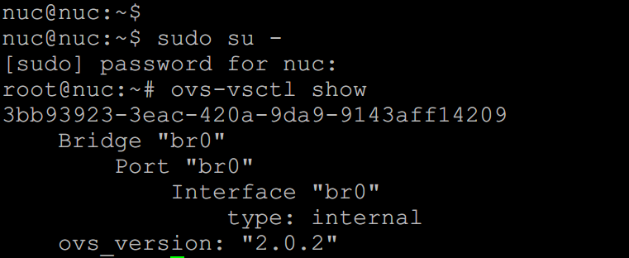
Open Vswitch - Configure bridged networking
$sudo ovs-vsctl add-br br0

Slide 22
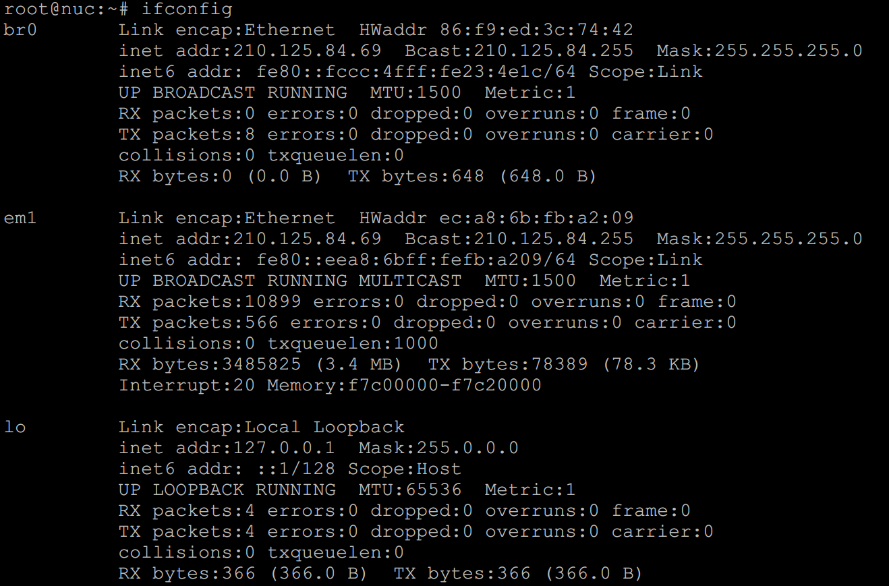
Open Vswitch - Configure bridged networking
$sudo ovs-vsctl add-port br0 eth0
eth0 인터페이스가 global 영역에서 bridge 영역으로 이동하기 때문에 연결이 끊김

Slide 23
Open Vswitch - Configure bridged networking
$sudo ip route flush table main // Removing routing table of OS
$sudo ip addr flush dev eth0 // Removing the IP address of eth0
$sudo ip addr flush dev br0 // Removing the IP address of br0
$sudo ifup br0 // Turning on “br0” interface
$sudo ip link set eth0 up // Turning on “eth0” interface

Slide 24
Open Vswitch - Situation
Your Box
Your Box
br0
203.237.x.x
eth0
203.237.x.x
eth0
0

Slide 25
Open Vswitch - Goal of this section
Your Box
VM
203.237.x.x
br0
203.237.x.x
eth0
Stop OvS setting, Now need to build KVM

Slide 26
KVM: Goal of this part
VM

Slide 27

What is KVM?
KVM (for Kernel-based Virtual Machine) is a full virtualization solution for Linux on x86 hardware containing virtualization extensions (Intel VT or AMD-V). It consists of a loadable kernel module, kvm.ko, that provides the core virtualization infrastructure and a processor specific module, kvm-intel.ko or kvm-amd.ko.
Using KVM, one can run multiple virtual machines running unmodified Linux or Windows images. Each virtual machine has private virtualized hardware: a network card, disk, graphics adapter, etc.
KVM is open source software. The kernel component of KVM is included in mainline Linux, as of 2.6.20. The userspace component of KVM is included in mainline QEMU, as of 1.3.

Slide 28
KVM - install dependency to upgrade KVM
Install dependency & download Ubuntu 16.04.4 64bit server image.
$sudo apt-get install qemu-kvm libvirt-bin //upgrade KVM //qemu is open-source emulator
$wget http://kr.archive.ubuntu.com/ubuntu-releases/16.04/ubuntu-16.04.4-server-amd64.iso
Now we are ready to make VM. So continue the setting.

Slide 29
Open Vswitch - Configure bridged networking
Let’s make a tap interface and attach it to your VM.
$sudo vi /etc/network/interfaces
----------------- /etc/network/interfaces -----------------
…
(Append the lines below to the config file)
auto tap0
iface tap0 inet manual
pre-up ip tuntap add tap0 mode tap
up ip link set dev tap0 up
post-down ip link del dev tap0

Slide 30
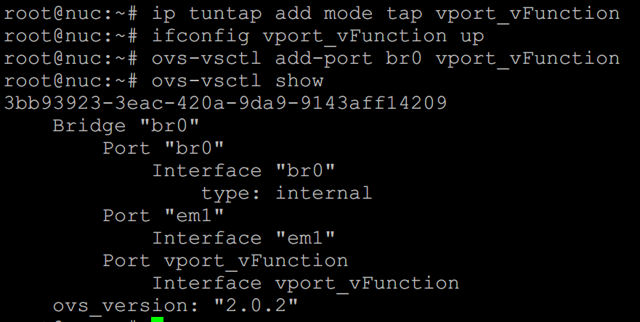
Open Vswitch - Configure bridged networking
Turn on the tap interface and attach it to your VM.
$sudo ifup tap0
$sudo ovs-vsctl add-port br0 tap0 // Turn on and attach to br0
This tap device will be attached VM. You can think this tap as a NIC of VM.
Your Box
VM
203.237.x.x
tap0
br0
203.237.x.x
[tap_name]
eth0

Slide 31
KVM - Prepare for Ubuntu VM
Make a VM image.
$sudo qemu-img create [img_name].img -f qcow2 [storage_capacity]
$sudo qemu-img create vFunction20.img –f qcow2 10G
Result..
Boot VM image from Ubuntu iso file (mac should be different from others).
$sudo kvm -m [memory_capacity] -name [vm_name] -smp cpus=[#cpu],maxcpus= [#maxcpu] -device virtio-net-pci,netdev=net0,mac= [EE:EE:EE:EE:EE:EE] -netdev tap,id=net0,ifname= [tap_name],script=no -boot d [img_name].img -cdrom ubuntu-16.04.4-server-amd64.iso -vnc :[#] –daemonize -monitor telnet:127.0.0.1:3010,server,nowait,ipv4
$ sudo kvm -m 512 -name tt -smp cpus=2,maxcpus=2 -device virtio-net-pci,netdev=net0 -netdev tap,id=net0,ifname=vport_vFunction,script=no -boot d vFunction20.img -cdrom ubuntu-16.04.4-server-amd64.iso -vnc :5 -daemonize -monitor telnet:127.0.0.1:3010,server,nowait,ipv4
Install VNC viewer and see inside of VM
$sudo apt-get install xvnc4viewer
$xvnc4viewer localhost :5

Slide 32
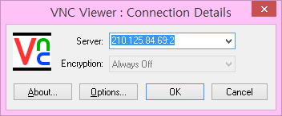
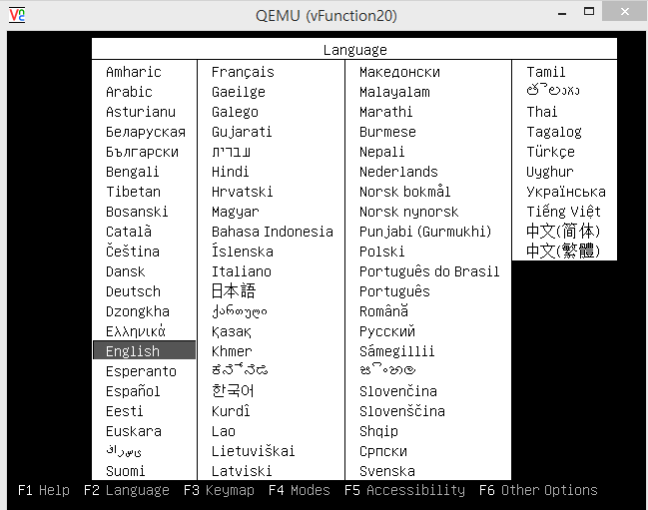
KVM - Install Ubuntu to VM
IP address:vnc number
ex) 210.203.x.x:5

Slide 33
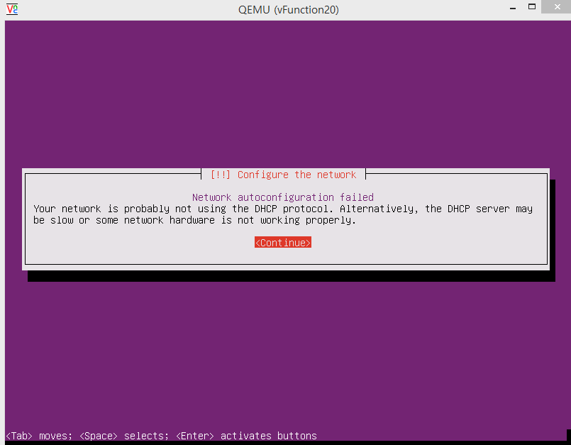

Slide 34
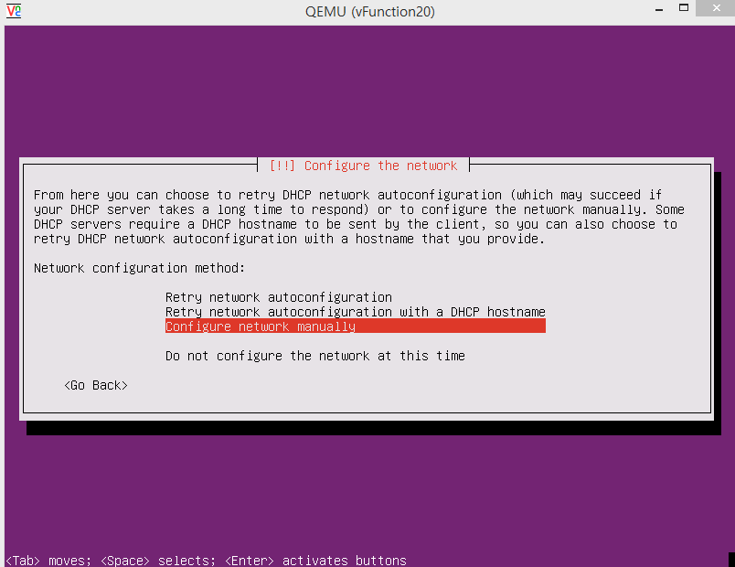

Slide 35
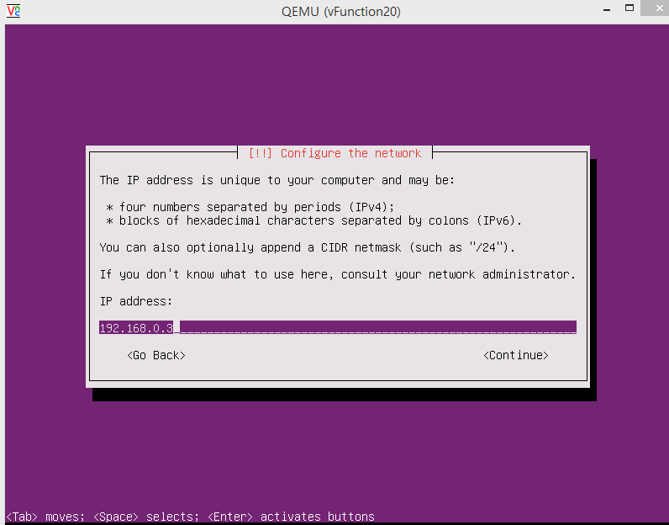
public address

Slide 36
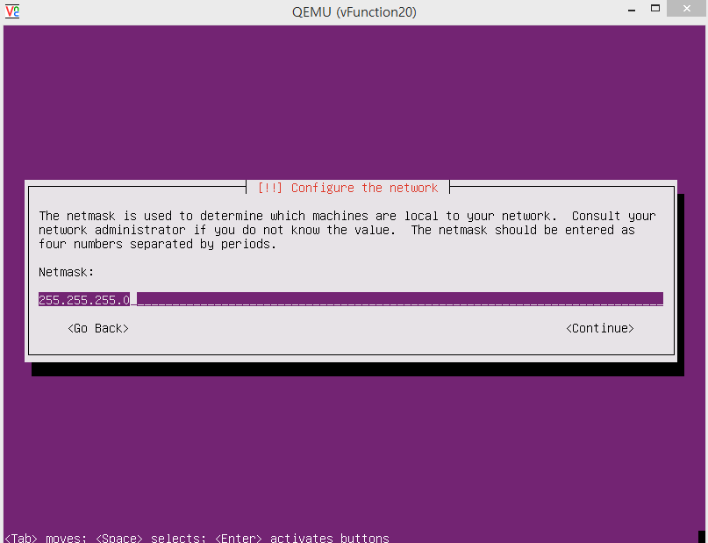

Slide 37
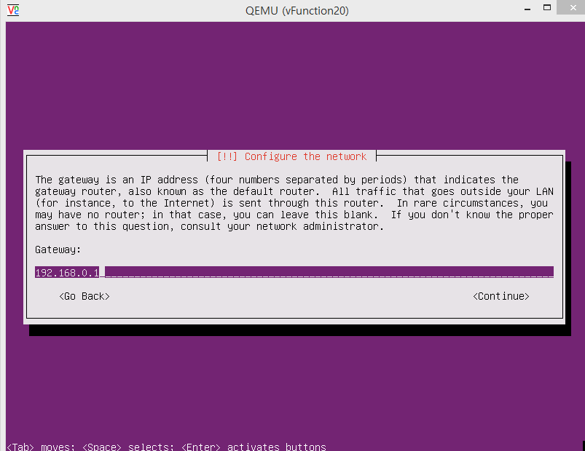
Gateway ip of your public network

Slide 38
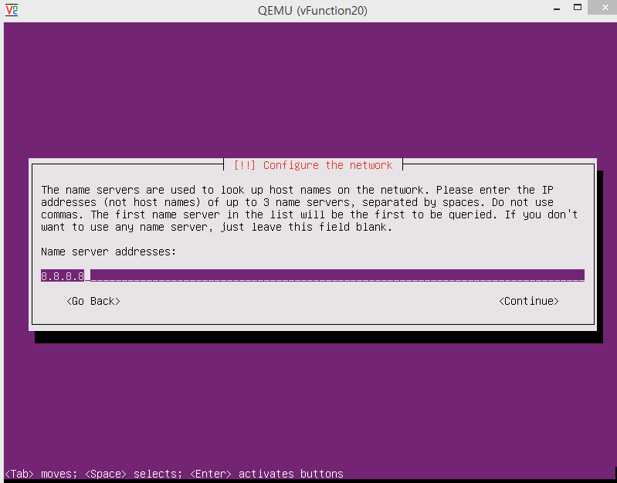
Google DNS server

Slide 39
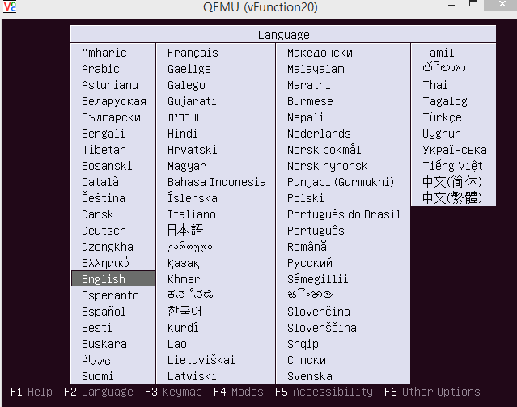
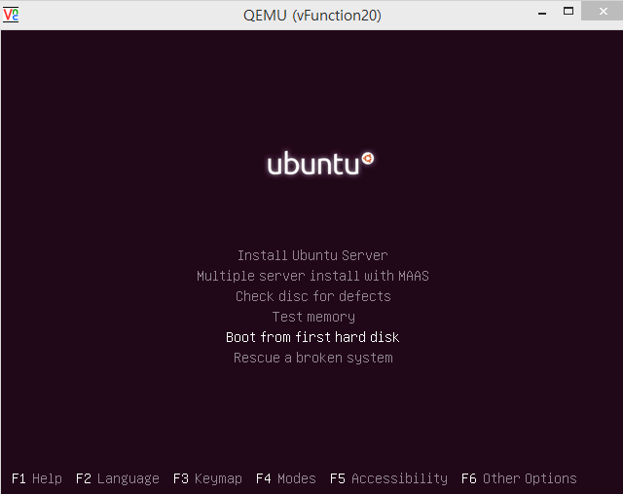
After installing Ubuntu Linux on the VM….
You need to eject Ubuntu install image before booting to the installed OS
$telnet localhost 3010
Trying 127.0.0.1...
Connected to localhost.Escape character is '^]'.
QEMU 0.11.0 monitor - type 'help' for more information
(qemu) eject ide1-cd0
Push esc

Slide 40
KVM - VM boot command
If you want boot VM again (mac should be different from others).
$sudo kvm -m [memory capacity] -name [name] -smp cpus=[#cpu],maxcpus= [#maxcpu] -device virtio-net-pci,netdev=net0,mac= [EE:EE:EE:EE:EE:EE] –netdev tap,id=net0,ifname= [tap_name],script=no -boot d [name].img -vnc : [#] -daemonize

Slide 41
Open Vswitch connects with KVM - Situation
VM
ip : 203.237.x.x
tap_name
br0
ip : 203.237.x.x
eth0
ip : 0

Slide 42
Open Vswitch connects with KVM - Situation
VM
ip : 203.237.x.x
gateway: br0’s IP
tap_name
br0
ip : 203.237.x.x
eth0
ip : 0

Slide 43
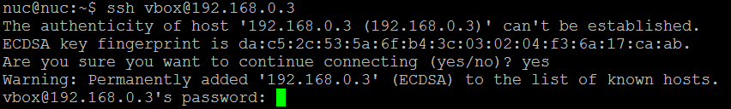
KVM - Don’t forget to install ssh in VM!
In VMs,
$sudo apt-get update
$sudo apt-get install ssh

Slide 44
Docker: Goal of this part

Slide 45
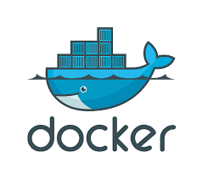
What is Docker ?
Docker is an open platform for building, shipping and running distributed applications. It gives programmers, development teams and operations engineers the common toolbox they need to take advantage of the distributed and networked nature of modern applications.

Slide 46
Docker - Installation
Docker installation.
$sudo wget -qO- https://get.docker.com/ | sh
$sudo systemctl start docker
$sudo adduser [Your_account] docker
(Session restart)
$sudo docker run hello-world
reference: http://docs.docker.com/linux/step_one/

Slide 47
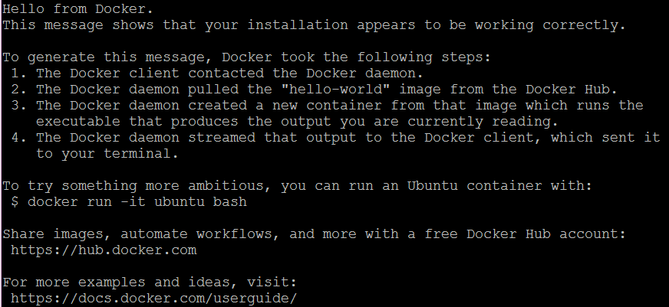
Docker - Installation

Slide 48
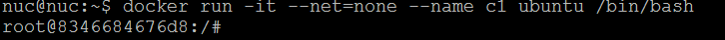
Docker - Make containers
Run docker container.
$sudo docker run -it --net=none --name [container_name] ubuntu /bin/bash
I want to make interface that has 203.237.x.x IP address.
※ctrl + p, q → detach docker container
※docker attach [container_name] → get into docker container console

Slide 49
Docker - About [--net host] option
Pros
Easy to use
Cons
Security problem (Violate docker’s strong point:isolated)
Solution?
Establish L2 tunneling (Can easily achieved by using ovs. However, ovs doesn’t support raspberry pi officially. That’s why we are using this option.) Related keyword : GRE, vlan, vxlan

Slide 50
Docker - Connect docker container to ovs bridge
Install ovs-docker utility in host machine. (Not in inside of Docker container.)
$sudo ovs-docker add-port br0 eth0 [containerName] --ipaddress=[IP_address]/24 --gateway=[Gateway_address]
$sudo docker attach [containerName]
#apt-get update
#apt-get install net-tools
#apt-get install iputils-ping

Slide 51
Modify - /etc/rc.local
Modify /etc/rc.local
$sudo vi /etc/rc.local
docker start [container_name]
ovs-docker del-port br0 eth0 [containerName]
ovs-docker add-port br0 eth0 [containerName] --ipaddress=[IP_address/24] --gateway=[Gateway_address]
Whenever NUC is rebooted,
network configuration of Docker container is initialized
by executing commands in rc.local

Slide 52
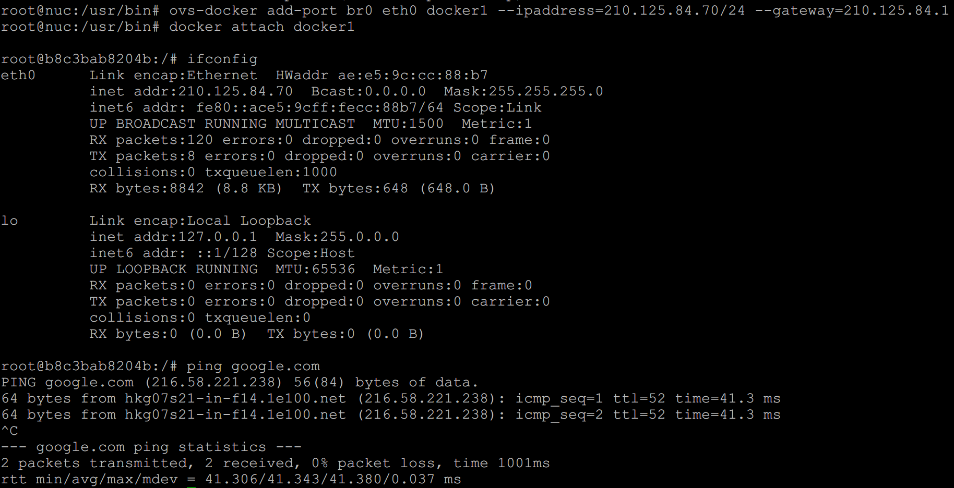


Docker - Check connectivity

Slide 53
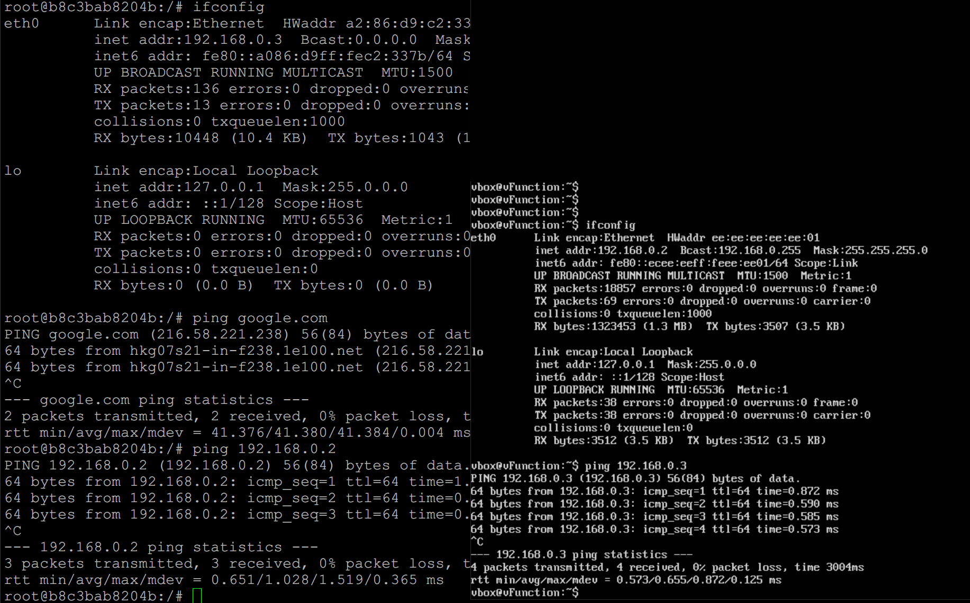
Docker connect with KVM - Check connectivity
Docker container
KVM VM

Slide 54
Box Lab: Final Goal
VM

Slide 55
Appendix

Slide 56

NUC OS Setting

Slide 57
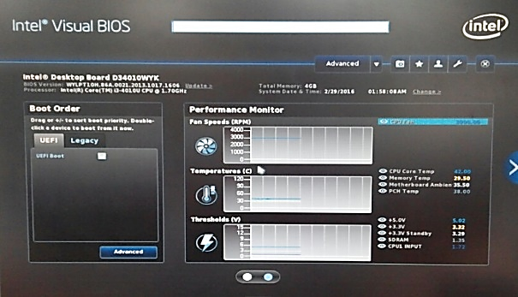
NUC OS Setting
BIOS Setting (64bit OS 설치시 필요)
Booting 후 F2 버튼을 통해 BIOS Setting 화면으로 접속
UEFI boot 체크 해제, (Legacy 방식으로 부팅)

Slide 58
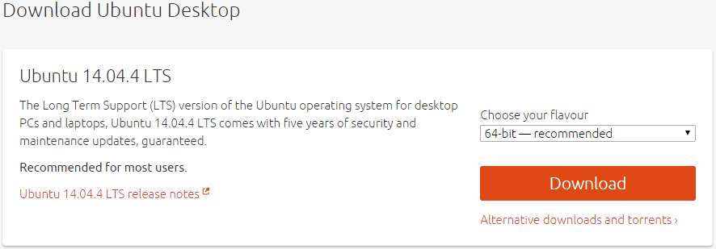
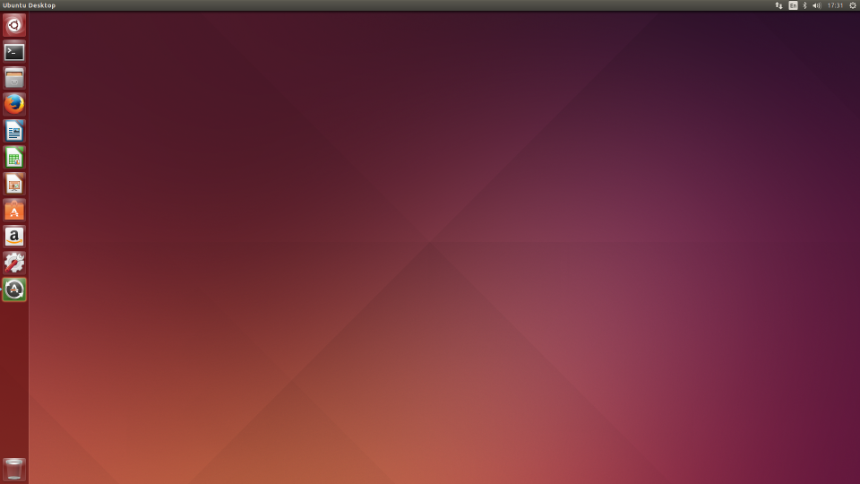
NUC OS Setting
OS : Ubuntu Desktop 14.04.4 LTS(64bit)
Download Site : http://www.ubuntu.com/download/desktop
OS 설치를 위해 download 된 파일(ubuntu-14.04.4-desktop-amd64.iso, 0.99Gb)을 이용하여 bootable USB 구성(bootable CD 는 불가능, NUC에 CD-Rom이 없음)
NUC에 설치
설치 완료 후 Ubuntu 초기화면

Slide 59
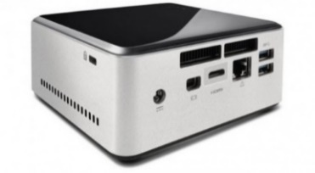
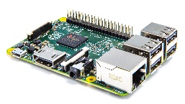
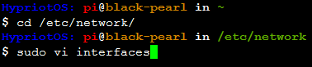
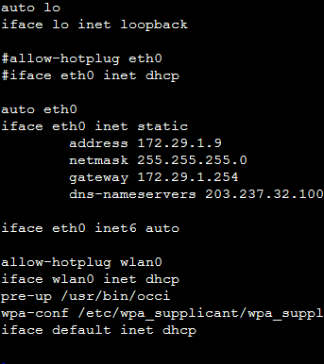
NUC & Pi2 IP address Setting
Pi2 IP address 설정을 위해 필요한 파일(편집은 root 만 가능)
/etc/network/interfaces
일반적으로 dns-nameservers 를 입력하면 9 page 는 필요 없으나, Hypriot OS 는 삽입되지 않으므로 resolv.conf 파일에 직접 nameserver를 입력해야 함!
$cd /etc/network
$sudo vi interfaces
#iface eth0 inet dhcp ← # 은 주석
auto eth0
iface eth0 inet static
address 172.29.0.X ← ip address
netmask 255.255.255.0 ← subnet mask
gateway 172.29.0.254 ← Gateway
dns-nameservers 203.237.32.100 203.237.32.101
입력 예

Slide 60
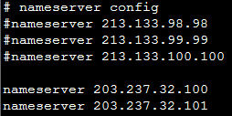
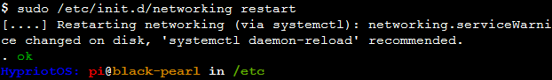
NUC & Pi2 IP address Setting
Pi2 IP address 설정을 위해 필요한 파일
/etc/resolv.conf
기존의 nameserver는 #을 추가하여
주석처리
$cd /etc/
$sudo vi resolv.conf
$sudo /etc/init.d/networking restart 입력 또는 rebooting 후 network 확인
$sudo reboot (rebooting command)
# nameserver config
nameserver 203.237.32.100
nameserver 203.237.32.101

Slide 61
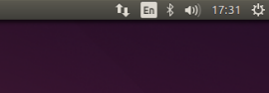
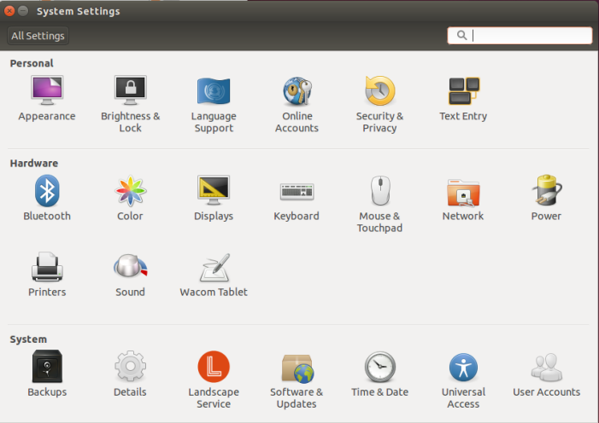

NUC & Pi IP address Setting
NUC IP address Setting
Pi와 동일하게 진행
GUI 환경에서 setting
Network icon
Edit Connection.. 선택
System Setting icon

Slide 62
Linux Setting(NUC & Pi)
Ubuntu & Hypriot OS : Debian 계열 linux
Package 관리 관련 명령어(apt-get : Advanced Packaging Tool)
Update package index 갱신(/etc/apt/sources.list)
Package 목록을 비교하여 package upgrade 실행
Package 간의 의존성 검사를 하며 upgrade(optional)
Package 설치(/var/cache/apt/archive/에 설치)
자신에 맞는 기본적인 package 설치
Kernel Lab(Pi2)을 위한 package : gcc-4.9, make
Editor : vim(vi iMproved), emacs, gedit, etc.
SSH(Secure Shell) : openssh
$sudo apt-get update
$sudo apt-get upgrade
$sudo apt-get dist-upgrade
$sudo apt-get install <package_name>

Slide 63

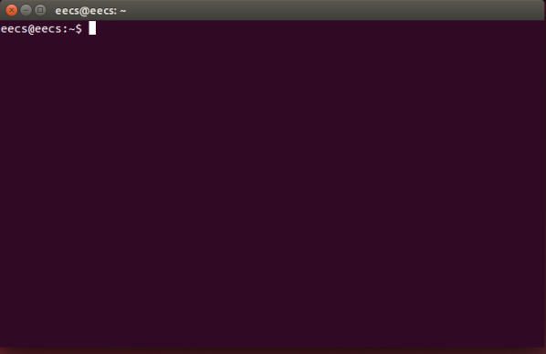
Linux Beginner Guide
Terminal 창
< 간단한 명령어 모음 >
$pwd : 현재위치
$cd : Change directory
$ls : directory 보기
$mkdir : directory 생성
$su : root 계정으로 이용
$apt-get : package 설치 및 삭제
$poweroff
$shutdown –h now
eecs@eecs:~$
user
hostname
home directory

Slide 64
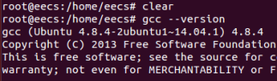
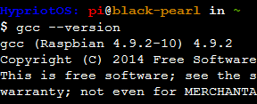
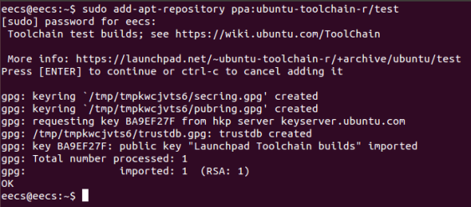
Linux Beginner Guide
gcc-4.9 설치(NUC & Pi2)
gcc 설치
gcc version 확인 :
NUC 에 gcc 설치를 위해 아래의 command 실행
$sudo apt-get install gcc-4.9
$gcc --version
< NUC >
< pi2 >
$sudo add-apt-repository ppa:ubuntu-toolchain-r/test
$sudo apt-get update
$sudo apt-get install gcc-4.9

Slide 65
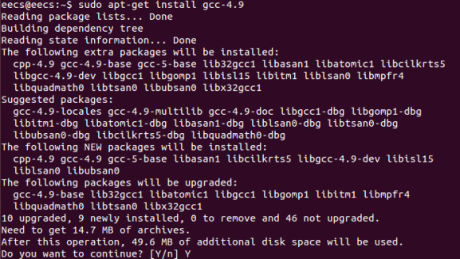

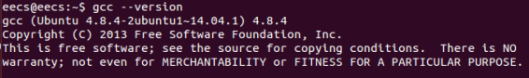
Linux Beginner Guide
gcc-4.9 설치(NUC & Pi2)
version 확인
link 설정을 해주면 된다.

Slide 66
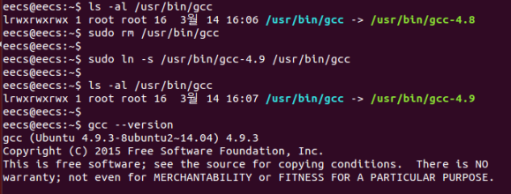

Linux Beginner Guide
gcc-4.9 link 설정
현재 gcc-4.8 version 이 link 되어 있음
현재의 link 를 지우고 4.9 version으로 재설정
$sudo rm /usr/bin/gcc : link 삭제
$sudo ln –s /usr/bin/gcc-4.9 /usr/bin/gcc : link 설정

Slide 67

Vi/vim editor 명령어 모음
입력 모드 : 원하는 글자를 입력
: 현재 위치의 다음부터 입력 시작
: 현재 위치의 앞에서부터 입력 시작
명령 모드 : 문서 편집을 할 수 있으며, 입력 모드 상태에서 ESC키를 누르면 명령모드로 전환됨
: 커서가 있는 문자 삭제
: 현재 줄 전체 삭제
라인 모드 : ESC 키를 누른 후 colon(:) prompt 에서 명령을 입력하며 저장, 편집, 검색 기능 제공
: 그대로 종료하기
: 변경된 내용을 저장하지 않고 종료하기
: 변경된 내용을 저장하고 종료하기
보다 다양한 명령어가 있으며, 직접 실습을 하는 것이 좋은 방법
a
i
x
dd
:q
:q!
:wq

Slide 68
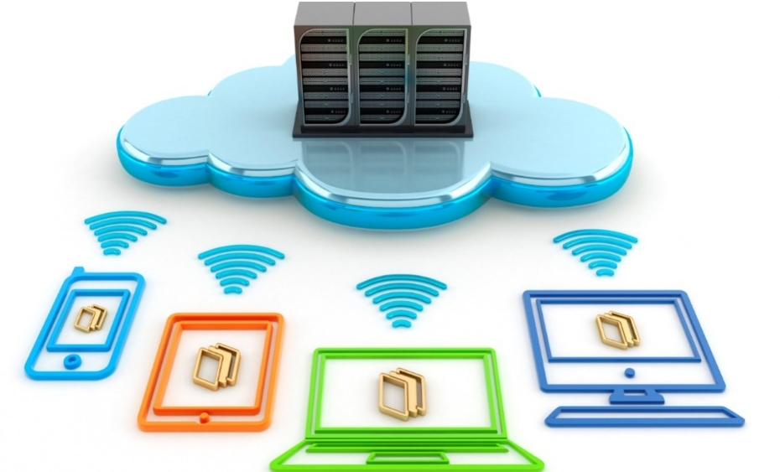
Thank You for
Your Attention
Any Questions?

